Slide 1



Flood and
Landslide Prediction
using Machine Learning

Slide 2


ABSTRACT
Natural disasters such as landslides and floods pose significant challenges, particularly in regions with complex topography and vulnerable populations.
This study presents a machine learning-based approach to predict landslides and flood insecurity in susceptible areas.
By integrating various datasets, including historical weather patterns, dam levels, land use, weather data, and socio-economic indicators, the model aims to provide early warnings and actionable insights.
The models are validated using real-world data from high-risk regions, and the results demonstrate a significant improvement in prediction accuracy compared to traditional methods.

Slide 3
Introduction
In recent years, the frequency and severity of natural disasters have raised significant concerns about flood security and the safety of vulnerable regions.
Landslides, in particular, severely threaten infrastructure and human lives, especially in mountainous and hilly terrains.
The Role of Machine Learning:
Machine learning (ML) offers innovative solutions to these challenges. By leveraging large datasets and sophisticated algorithms, ML can accurately predict floods and landslide occurrences.
These predictions allow for better preparedness and timely interventions, ultimately saving lives and resources.

Slide 4
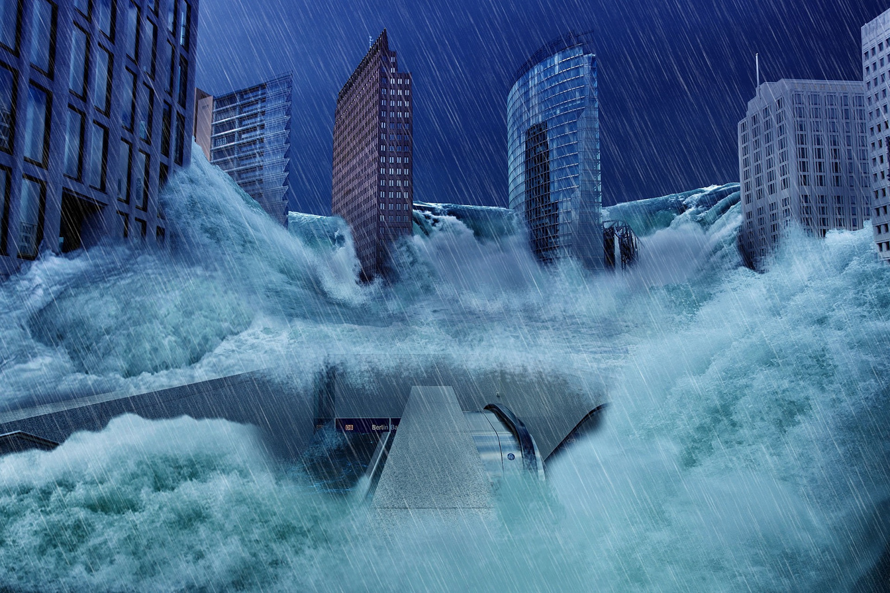
Focus of the Project
Flood Prediction: Using machine learning to analyze factors like climate, Dam Levels, weather data, and Environment conditions to predict food shortages and ensure food security.
Landslide Prediction: Employing machine learning models to forecast landslides by analyzing geological data, weather patterns, and topographical features.

Slide 5
EXISTING SYSTEM
Hydrological Models Integrated with Machine Learning
Hydrological models simulate the water cycle, including precipitation, runoff, infiltration, and water flow. Integrating these models with ML enhances prediction accuracy.
Remote Sensing and Satellite Data Analysis
Remote sensing technology provides critical data on land use, vegetation cover, and water bodies, which are essential for flood and landslide prediction.
Rainfall-Runoff Models
Rainfall-runoff models predict the amount of water runoff based on precipitation data, which is crucial for flood forecasting.

Slide 6


EXISTING SYSTEM DISADVANTAGES
Data Scarcity:
In some regions, there is a lack of high-quality data, which can limit model accuracy.
Computational Complexity:
Advanced models require significant computational resources.
Model Interpretability:
Complex models, especially deep learning ones, can be difficult to interpret, making it challenging to understand how predictions are made.

Slide 7
PROPOSED SYSTEM
The proposed system leverages machine learning techniques to predict floods and landslides by analyzing a variety of environmental and meteorological data.
This system integrates data from multiple sources, including satellite imagery, rainfall patterns, topographic information, soil moisture levels, and river flow rates.
By applying advanced algorithms such as Convolutional Neural Networks, the system can detect complex patterns and correlations within the data that are indicative of potential flood and landslide events.
The predictive model is continuously trained and refined with new data to improve accuracy over time.

Slide 8
PROPOSED SYSTEM
The system also includes a real-time monitoring component, which enables the rapid identification of high-risk areas and provides early warnings to relevant authorities and communities.
This proactive approach to disaster management aims to minimize the impact of these natural hazards, safeguarding lives and property.
Flood and landslide prediction using machine learning involves using historical data, environmental variables, and advanced algorithms to predict the likelihood of these natural disasters.

Slide 9
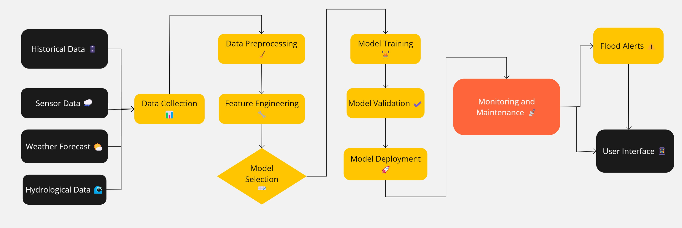
ARCHITECTURE

Slide 10
METHODOLOGY
Data Preprocessing:
Cleaning:
Removing or correcting inaccurate data points.
Normalization:
Scaling data to a common range to improve model performance.
Feature Engineering:
Creating new variables or features that may help the model understand patterns in the data better.
Data Collection:
Meteorological Data:
Includes rainfall, temperature, humidity, and other climate-related factors.
Geographical Data:
Terrain features, soil type, elevation, slope, and land cover.
Hydrological Data:
River flow, water levels, and soil moisture.
Historical Data:
Past occurrences of floods and landslides, including their intensity and impact.
1
2

Slide 11
METHODOLOGY
Model Selection:
Statistical Models:
Traditional approaches like logistic regression, time series analysis, and ARIMA models are still used for certain predictions.
Machine Learning Models:
Algorithms like Convolutional Neural Networks are trained using labeled data to predict floods and landslides.
Deep Learning Models:
Recurrent Neural Networks (RNNs) for temporal data are increasingly used.
Prediction Model:
Real-time Prediction:
Once trained, the model can be used to predict floods and landslides in real-time based on current data inputs.
Early Warning Systems:
These predictions are integrated into early warning systems, providing alerts to authorities and the public.
3
4

Slide 12
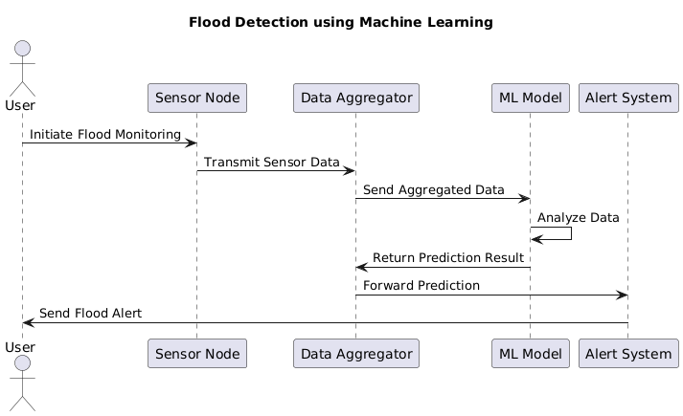
SEQUENCE DIAGRAM

Slide 13
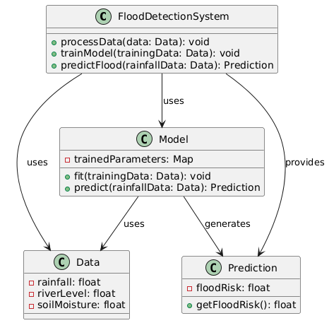
CLASS DIAGRAM

Slide 14
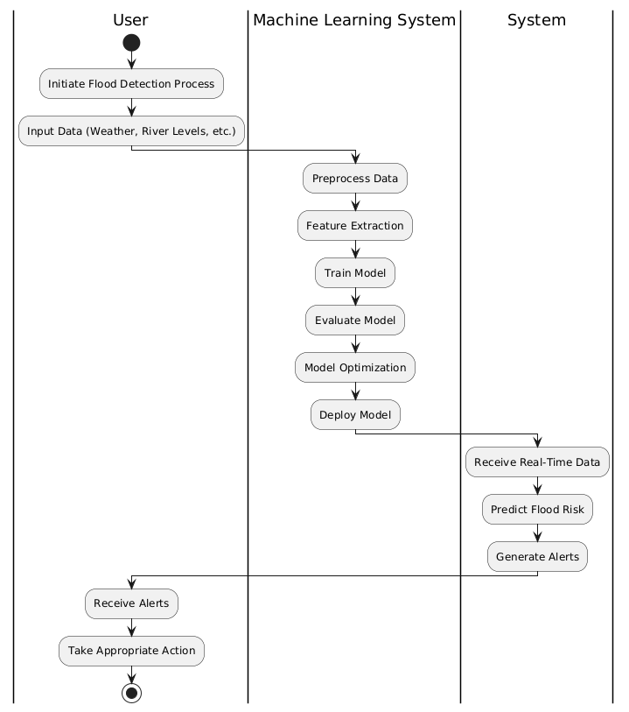
ACTIVITY DIAGRAM

Slide 15
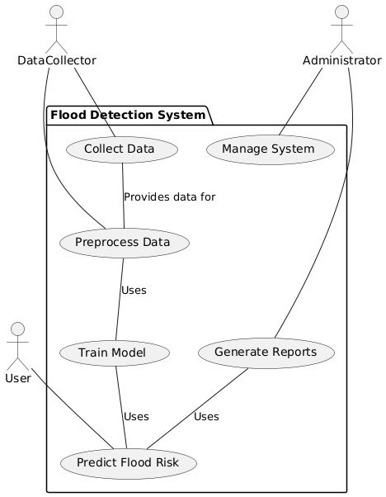
USE CASE DIAGRAM

Slide 16

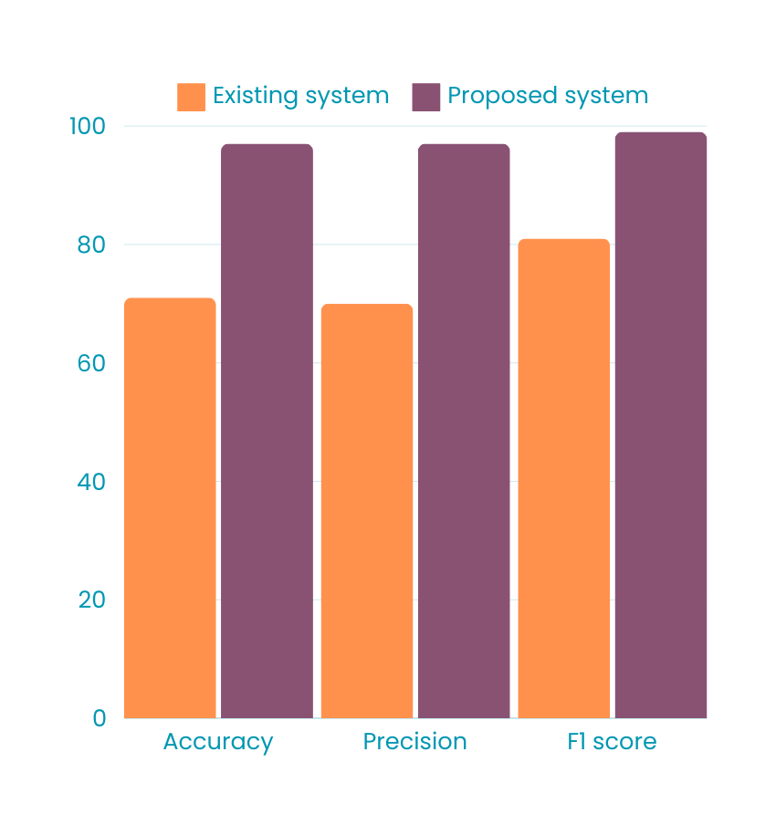
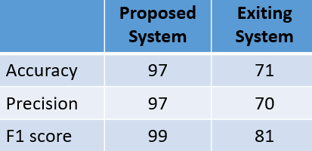
Results

Slide 17
HARDWARE SOFTWARE REQUIREMENTS
HARDWARE REQUIREMENTS:
System : Intel i3 Processor Mimimum.
Hard Disk : 20 GB Space
Monitor : 15’’ LED
Input Devices : Keyboard, Mouse
Ram : 4 GB
SOFTWARE REQUIREMENTS:
Operating system : Windows, Mac OS.
Coding Language : Python, HTML, CSS,JS
Web Framework : Flask

Slide 18
Conclusion
In conclusion, the integration of CNN Algorithm in flood and landslide prediction represents a significant advancement in our ability to anticipate and mitigate the impacts of these natural disasters.
By leveraging vast datasets, including historical weather patterns, topography, and soil conditions, machine learning models can provide accurate and timely predictions, enabling better preparedness and response.
As technology continues to evolve, the accuracy and efficiency of these models will only improve, offering hope for more resilient communities in the face of increasingly unpredictable environmental challenges.

Slide 19
REFERENCE
[1] H. Hapuarachchi, Q. Wang, and T. Pagano, “A review of advances in f lash flood forecasting,” Hydrological processes, vol. 25, no. 18, pp. 2771–2784, 2011.
[2] A. Wannachai, S. Aramkul, B. Suntaranont, Y. Somchit, and P. Cham prasert, “Hero: Hybrid effortless resilient operation stations for flash f lood early warning systems,” Sensors, vol. 22, no. 11, p. 4108, 2022.
[3] S. Zhong, C. Wang, Z. Yu, Y. Yang, and Q. Huang, “Spatiotemporal exploration and hazard mapping of tropical cyclones along the coastline of china,” Advances in Meteorology, vol. 2018, 2018.
[4] C. Hu, Q. Wu, H. Li, S. Jian, N. Li, and Z. Lou, “Deep learning with a long short-term memory networks approach for rainfall-runoff simulation,” Water, vol. 10, no. 11, p. 1543, 2018.
[5] Z. Fang, Y. Wang, L. Peng, and H. Hong, “Predicting flood susceptibility using lstm neural networks,” Journal of Hydrology, vol. 594, p. 125734, 2021.

Slide 20
Thank
You

